Slide 1

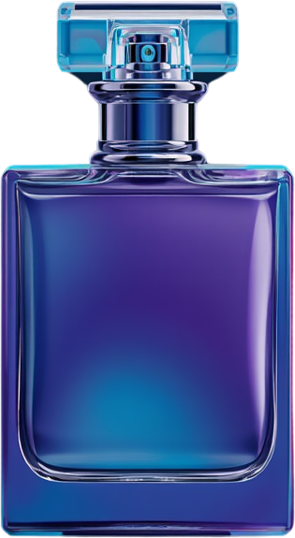

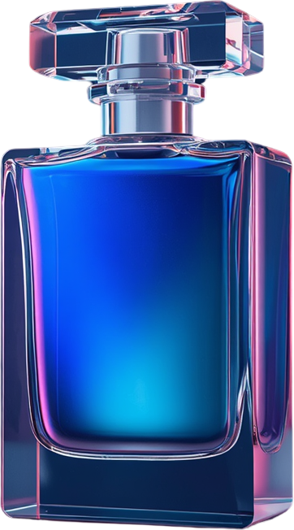
Rwi7a.
Presented by : Med Chakir
2026
Premium Accessible Fragrances
Pitch Deck
Redefining Luxury for Everyone

Slide 2


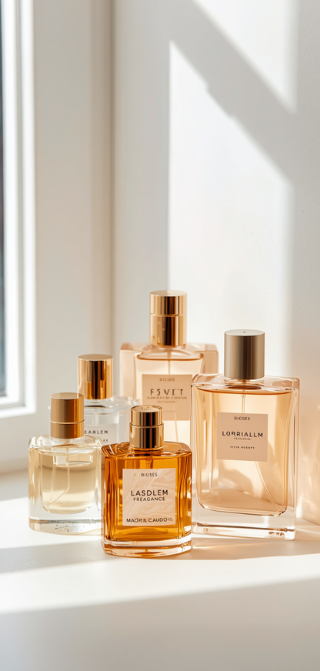
Fragrance Co.
Startup Pitch Deck
The Problem & Market Gap
Presented by: Chakir
Page 2 of 10
The Problem
High-end designer perfumes are extremely expensive, making luxury fragrances inaccessible for everyday buyers. Cheap alternatives often have poor longevity, fading within an hour, and lack quality ingredients. Consumers struggle to find a balance between authentic, long-lasting luxury scents and affordable pricing.
The Issue
Market Gap
Consumers want to express their personality through signature scents but cannot afford luxury retail prices. The lack of accessible options forces buyers to choose between quality and affordability—a decision that limits their self-expression and daily choices.
The luxury fragrance market is saturated with expensive designer brands priced beyond reach for most consumers. Meanwhile, budget alternatives fail to deliver quality, leaving a significant gap in the market for affordable, premium-quality perfumes.

Slide 3
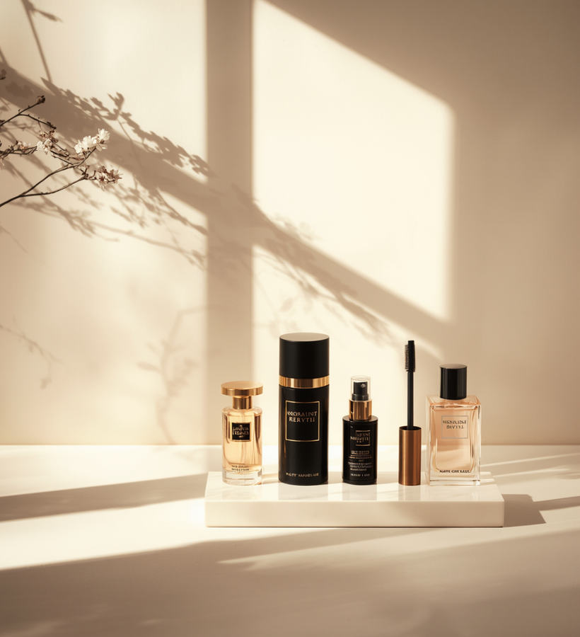
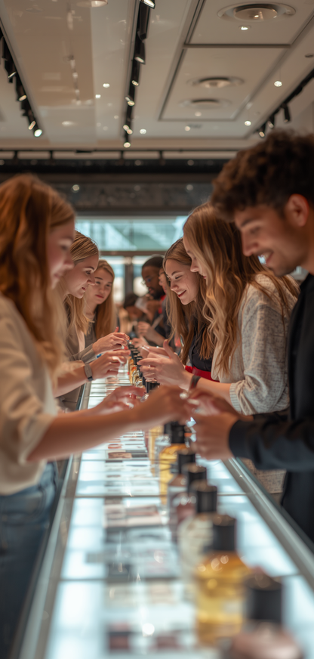
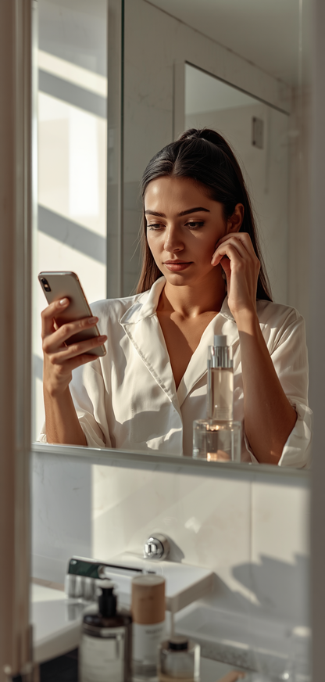
Rwi7a
Startup Pitch Deck
Business Presentation
Presented by: Chakir
Market Analysis
Market Opportunity
The fragrance market is experiencing unprecedented growth as consumers seek accessible luxury alternatives. Young professionals and students are increasingly willing to invest in signature scents that elevate their daily experiences, creating a perfect convergence of demand and opportunity for premium yet affordable perfumes.
E-Commerce Boom
Niche Scent Rise
The beauty and personal care e-commerce sector is booming, enabling direct-to-consumer sales models. Social commerce platforms are driving fragrance discovery and impulse purchases among younger demographics.
Alternative and niche scent profiling is rapidly gaining popularity over traditional mass-market brands. Consumers are drawn to unique, curated fragrances that reflect their personal identity and style preferences.

Slide 4
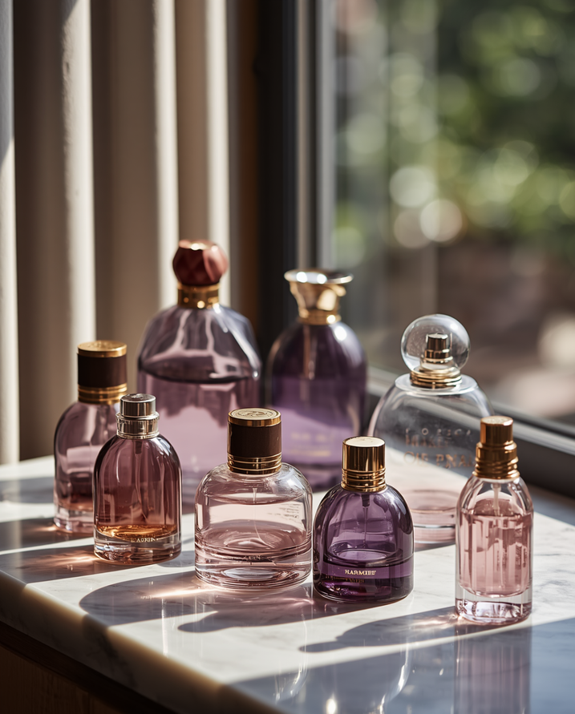
Rwi7a
Startup Pitch Deck
Business Presentation
Presented by: Chakir
GOAL
Our Solution
Premium accessible fragrances that bridge the gap between luxury quality and everyday affordability. We deliver high-concentration, long-lasting perfumes through direct sourcing and efficient distribution, cutting out unnecessary markups to offer you authentic luxury at a fraction of retail costs.
Direct Sourcing
Curated Collections
We eliminate unnecessary middlemen by partnering directly with premium fragrance oil suppliers. This streamlined approach reduces costs significantly while maintaining the highest quality ingredients, passing savings directly to our customers.
Our expertly curated scent profiles cater to modern preferences—fresh, woody, floral, and oriental. Each collection is thoughtfully designed to offer everyday luxury that stands out from mass-market alternatives.

Slide 5

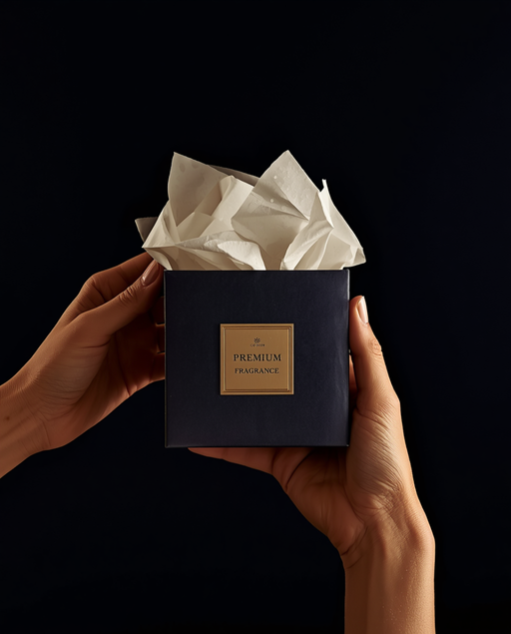
Rwi7a
Startup Pitch Deck
Business Presentation
Presented by : Chakir
Premium Fragrances
Our Engagement Charter
At Scent Haven, we are committed to delivering an exceptional customer experience through our core values. Our charter outlines our dedication to quality, transparency, and customer satisfaction in every bottle we create and every interaction we have with our community.
Quality First
Customer Satisfaction
We guarantee premium oil concentration in every bottle, ensuring exceptional longevity of 6+ hours. Our perfumes are crafted with high-quality ingredients that deliver rich, authentic scents that last throughout your day and evening.
Your happiness is our priority. We offer easy returns and a risk-free buying experience. Our dedicated support team is committed to resolving any concerns quickly, ensuring every customer enjoys a seamless and satisfying purchase journey.

Slide 6
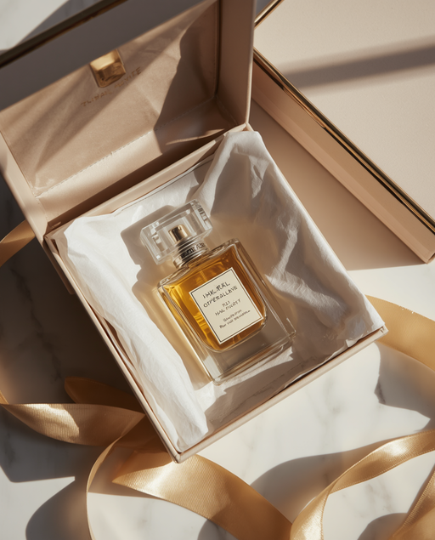
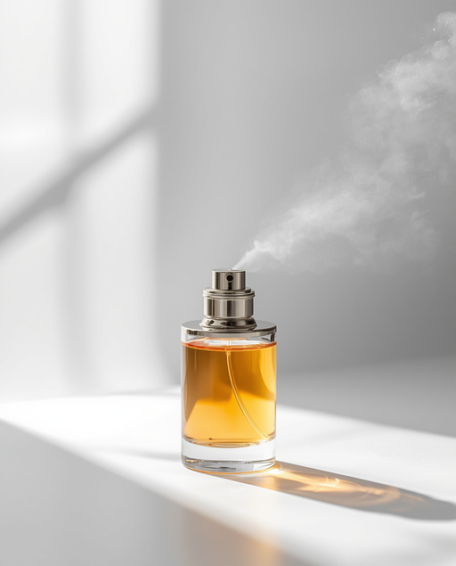
Rwi7a
Startup Pitch Deck
Business Presentation
Premium Fragrance Startup
Pitch Deck 2026
Our Promise
We stand behind every bottle we sell with unwavering commitment to quality and customer satisfaction. Our Customer Promise Charter ensures you receive premium luxury fragrances with complete peace of mind.
Signature Guarantee
Premium Experience
Every bottle delivers premium luxury notes or your money back. We're confident in our formulations, so we offer complete risk-free purchases with easy returns and no hidden fees.
Enjoy premium unboxing with complimentary sample testing included with every order. Our dedicated support team responds within 24 hours, 7 days a week, via social media and messaging channels.

Slide 7
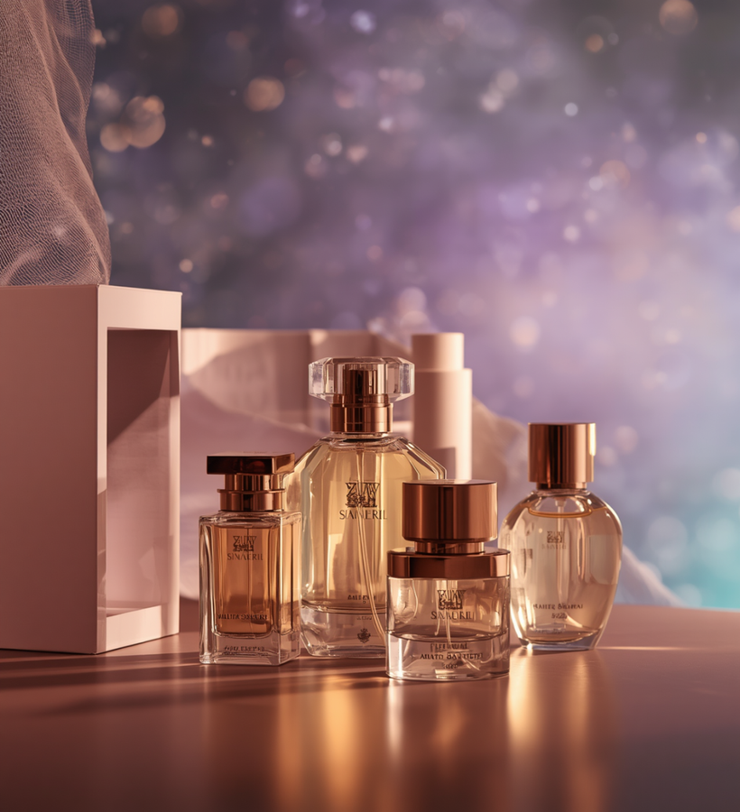


Rwi7a
Startup Pitch Deck
Premium Fragrances
Business Model Canvas
PLAN
Business Model
Our business model combines direct sourcing with premium quality to deliver accessible luxury. We partner with fragrance oil suppliers and local delivery couriers to minimize costs while maintaining quality standards.
Key Activities
Revenue Streams
Sourcing premium fragrances, branding and social media marketing, online order fulfillment, and customer relationship management through personalized recommendations.
Direct retail sales of perfume bottles, discovery sets, and bundle offers. Our focused product range allows competitive pricing while maintaining quality margins.

Slide 8
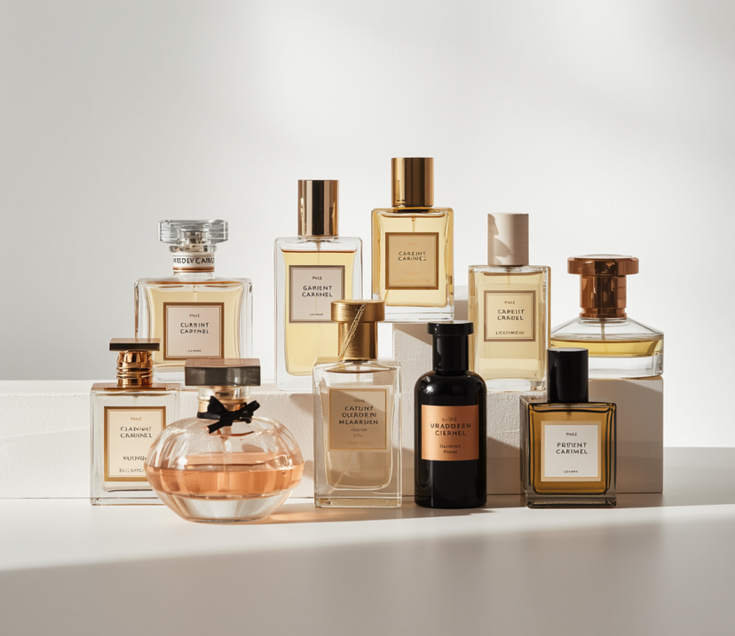
Rwi7a
Startup Pitch Deck
Achievement Overview
Premium Accessible Fragrances
Project Traction
+1K
Orders To be Received as a Goal
Our early momentum shows strong market validation. Steady sales growth with growing customer acquisition. Active social media community of engaged beauty enthusiasts. Positive testimonials praising scent longevity and premium presentation. Digital storefront fully operational.
Our Traction

Slide 9



Rwi7a
Startup Pitch Deck
Business Presentation
Presented by : Scent & Co.
Development Roadmap
Our Roadmap
Our strategic growth plan unfolds in three key phases, each designed to build momentum, expand our product offerings, and scale our operations nationwide while maintaining our commitment to quality and customer satisfaction.
Phase 1
Phase 2 & 3
Expand social media presence and run targeted local micro-influencer campaigns to build brand awareness and trusted community engagement.
Introduce new seasonal perfume collections and limited-edition discovery sets, then scale online store infrastructure and optimize nationwide delivery logistics for seamless customer experience.

Slide 10




Rwi7a
Startup Pitch Deck
Perfume Brand
Page 10 of 10
Connect With Us
+212 Tandiro nmra lol
https://www. rwi7a.pages.dev
Charika’s_email@domain.com

